Slide 1
Oral Presentation Skills

Slide 2
Meaning of Oral Presentation
• Oral presentation is the process of communicating information, ideas, or arguments to an audience through spoken words.
• It combines speech, visuals, and non-verbal cues to convey a message effectively.

Slide 3
Objectives of an Oral Presentation
• To inform the audience
• To persuade or influence opinions
• To educate or share knowledge
• To entertain and engage listeners
• To motivate or inspire action

Slide 4
Features of a Good Presentation
• Clear structure (Introduction–Body–Conclusion)
• Logical flow of ideas
• Effective use of visual aids
• Confident and engaging delivery
• Appropriate language and tone
• Audience interaction

Slide 5
Types of Oral Presentations
1. Informative Presentation – shares knowledge or facts
2. Persuasive Presentation – aims to convince or influence
3. Demonstrative Presentation – shows how to do something
4. Inspirational Presentation – motivates or inspires action
5. Business/Academic Presentation – reports, proposals, seminars

Slide 6
Steps for Effective Oral Presentation
1. Select and understand the topic
2. Analyze the audience
3. Plan and organize content
4. Prepare visual aids
5. Rehearse thoroughly
6. Deliver confidently
7. Handle questions effectively

Slide 7
Verbal and Non-Verbal Communication
Verbal: Clarity, tone, pace, pronunciation, vocabulary
Non-Verbal: Eye contact, gestures, posture, facial expressions, body language

Slide 8
Use of Visual Aids
• PowerPoint slides
• Charts and graphs
• Images or videos
• Demonstrations or props
• Must be clear, relevant, and not overloaded with text

Slide 9
Common Mistakes to Avoid
• Reading slides word-for-word
• Speaking too fast or too softly
• Overloading slides with text
• Ignoring audience feedback
• Poor time management

Slide 10
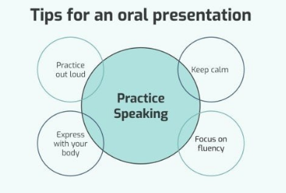

Slide 11
Conclusion
• A successful oral presentation requires clarity, confidence, and connection with the audience.
• Practice and preparation lead to impactful delivery.
• “Speak to express, not to impress.”

